Slide 1
AI final lab project
Lung tumor Detection Using Machine Learning
Delivered by:
1- Mostafa Nasser 120210001
2- Omar abd-elkareem 120210388
3- Yousef Mohamed amer 120210391

Slide 2
Abstract
PROBLEM:
Lung cancer diagnosis depends on the early detection of lung nodules. It takes a lot of time and is prone to human mistake to manually analyze CT scan pictures, particularly when nodules fluctuate in size and visibility.
APROACH:
We developed an automated solution using a YOLOv5-based object detection model to identify and localize lung nodules in 2D CT scan slices. The dataset consisted of annotated images in BMP format with corresponding XML files, which were converted into YOLO-compatible labels. The model was trained and evaluated using Google Colab and PyTorch.

Slide 3
CONT. ABSTRACT
RESULT:
Using a validation set of 62 CT scan images with 8 nodule instances, the trained YOLOv5 model was assessed. The precision of 0.108 and recall of 0.375 were attained by the model. At IoU 0.5 (mAP@50), the mean Average Precision was 0.0664, while at IoU-95, it was 0.0336. These findings show that while the model has started to detect nodules, especially smaller ones, there is still opportunity for further localization accuracy and precision. Although the metrics are small, the model shows promise as a supplementary tool for the diagnosis of lung nodules in their early stages.

Slide 4
Introduction : Biomedical Context and Motivation
Lung cancer is one of the major causes of cancer-related fatalities globally, owing primarily to its late diagnosis. Early diagnosis of pulmonary nodules, which are tiny lumps of tissue in the lung, can greatly improve treatment outcomes and survival rates. These nodules are frequently seen in computed tomography (CT) images and can be benign or cancerous.
However, finding these nodules, particularly smaller or less distinguishable ones, is a difficult and time-consuming operation for radiologists. Missing or delayed diagnoses can have serious ramifications for patient outcomes. As a result, there is an increasing demand for intelligent computer-aided detection (CAD) systems that can help clinicians detect worrisome nodules consistently and accurately.

Slide 5
CONT. INTRODUCTION
This research intends to use deep learning, specifically the YOLOv5 object detection method, to automate the detection of lung nodules in CT scan pictures. By increasing the speed and consistency of preliminary analysis, such systems can improve diagnostic procedures and perhaps reduce the number of early-stage malignancies overlooked.

Slide 6
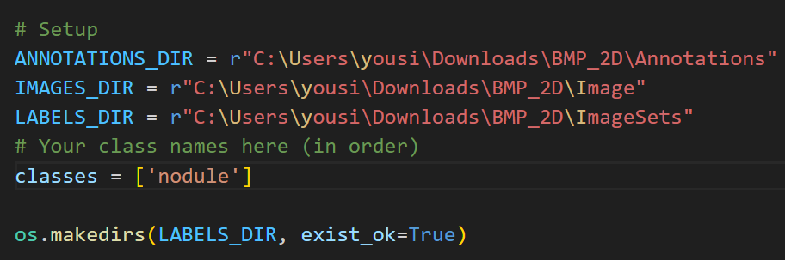
Methodology: AI/ML Approach
1- Data Preparation:
CT Image Collection: Gathered BMP-format lung CT scan slices containing pulmonary nodules.

Slide 7
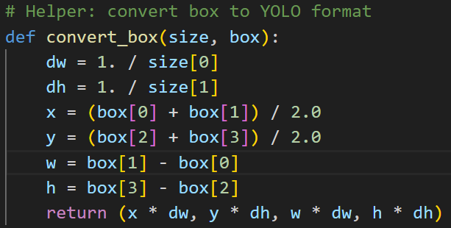
Cont. methodology
Annotation Parsing: Converted XML annotations (VOC format) to YOLO format (class x_center y_center width height) using bounding box coordinates.

Slide 8
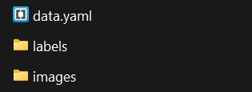
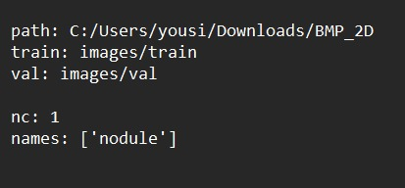

Cont. methodology
Dataset Structuring: Organized images and labels into images/train, images/val, labels/train, labels/val directories for YOLOv5.
Data Configuration: Created a data.yaml file specifying paths, number of classes (nc: 1), and class name (nodule).

Slide 9
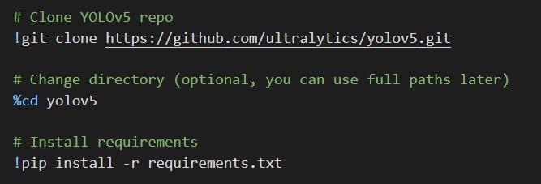
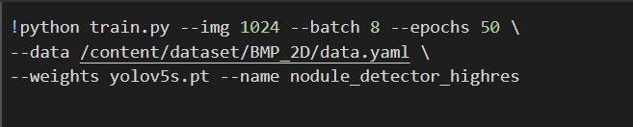
Cont. methodology
2- Model Training with YOLOv5
Environment Setup: Cloned YOLOv5 repository and installed required dependencies in Google Colab.
Model Selection: Used yolov5s.pt (smallest YOLOv5 model) for faster training and inference.
Training Configuration:
Image size: 1024×1024
Batch size: 8
Epochs: 50
Adjusted confidence threshold to improve sensitivity to small nodules.

Slide 10
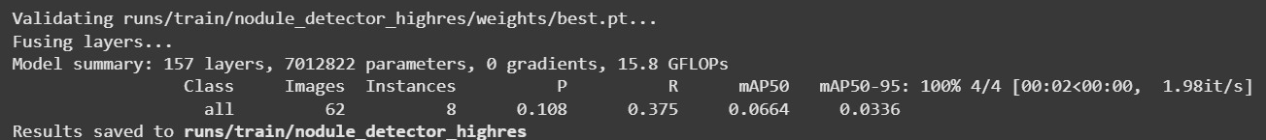
Cont. methodology
Training Execution: Launched training using train.py and monitored performance (Precision, Recall, mAP) during validation.

Slide 11
Cont. methodology
3- Model Evaluation and Inference
Validation: Evaluated model performance on the validation set: Precision: 0.108, Recall: 0.375, mAP@0.5: 0.0664

Slide 12
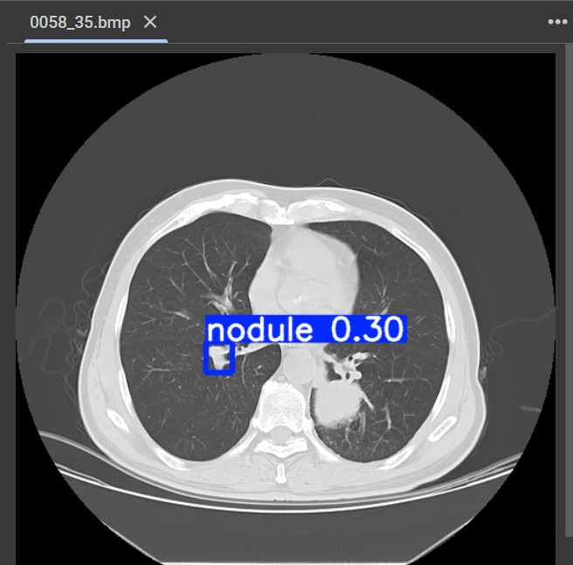
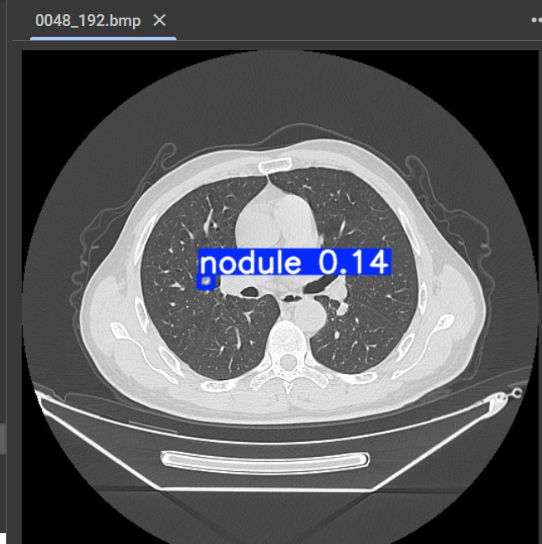
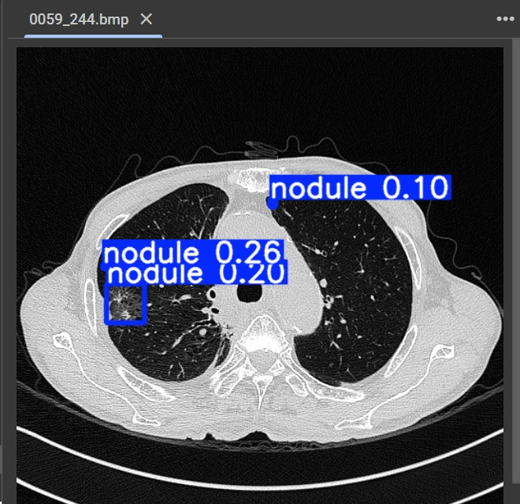
Cont. methodology
Detection Testing:
Ran inference on new images using detect.py to visualize predicted bounding boxes around nodules.
Saved predictions as both images and label text files for further analysis.

Slide 13
Results
1- Quantitative Results
Validation on the test set (62 CT images):
Detected Nodule Instances: 8
Precision (P): 0.108, Indicates the proportion of detections that were correct.
Recall (R): 0.375, Indicates how many of the true nodules were detected.
mAP@0.5: 0.0664, Mean Average Precision with IoU threshold = 0.5.
mAP@0.5:0.95: 0.0336, Average mAP over IoU thresholds from 0.5 to 0.95.

Slide 14
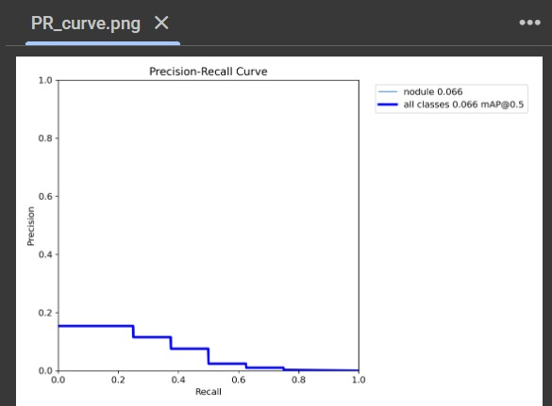
Cont. results
2-Performance Curves: the training process generates multiple performance graphs that were analyzed:
Precision-Recall (P-R) Curve: Helps visualize the trade-off between precision and recall. A flatter curve indicates weaker performance.

Slide 15
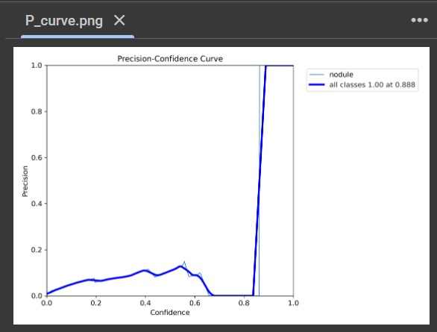
Cont. results
Confidence vs. Precision Curve: Shows how confident the model is in its predictions and how this correlates with actual performance.

Slide 16
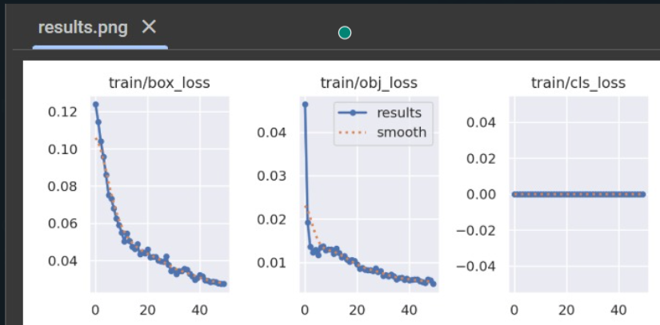
Cont. results
Loss Curves:
Box Loss: Indicates how well the model learns bounding box coordinates.
Objectness Loss: Reflects confidence in detecting objects vs. background.
Classification Loss: (Minimal in your case, as you have one class: "nodule").

Slide 17
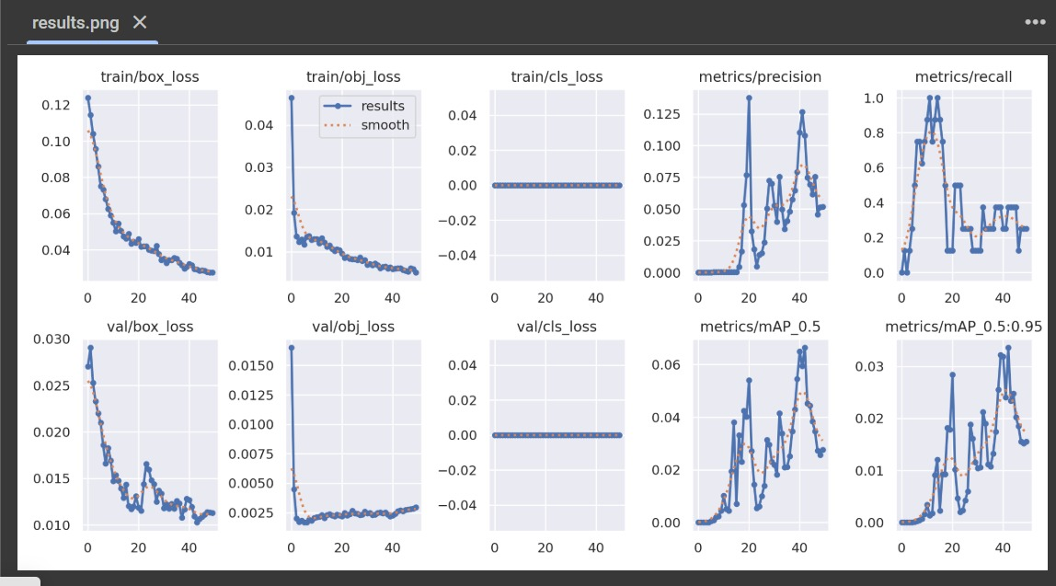
Cont. results
Collection of curves

Slide 18
Cont. results
Qualitative Results
Strengths: Accurately detects small nodules, which are often difficult for radiologists to spot.
Limitations: Tends to miss some larger nodules — could be due to annotation inconsistencies or insufficient variation in training samples.
Inference Output: Bounding boxes are drawn on inference images. Detection results are saved both as annotated images and .txt label files (with confidence scores).

Slide 19
Discussion
1- Limited Annotation Accuracy
Some large nodules were not detected, likely due to missing or imprecise annotations in the XML files. This affects the model’s ability to learn robust size-invariant features.
2- Single-Class Detection
The model was trained to detect only one class: nodule. This limits its diagnostic utility in real-world scenarios where differentiation between benign and malignant nodules is crucial.

Slide 20
Cont. Discussion
3- Small Dataset
Size The dataset used was relatively small, especially in terms of nodule diversity. This restricts the model’s generalization to new or rare cases.
4- Model Simplicity
YOLOv5s (small version) was used for training. While fast and lightweight, its detection performance may be limited compared to larger variants like YOLOv5m or YOLOv5x.
5- low Detection Confidence
Several valid nodules were detected only when the confidence threshold was manually reduced (e.g., 0.1). This suggests the model lacks high confidence in its detections.

Slide 21
Cont. Discussion
Future work
1- Improve Annotation Quality: Revisit and validate all XML files to ensure all nodules (especially larger ones) are correctly labeled.
2- Data Augmentation: Apply more advanced augmentation techniques (rotation, contrast variation, noise addition) to improve model robustness.
3- Model Upgrade: Experiment with more powerful detectors (e.g., YOLOv5m, YOLOv8, or even transformer-based models like DETR) for better accuracy.

Slide 22
THANK YOU

